Slide 1
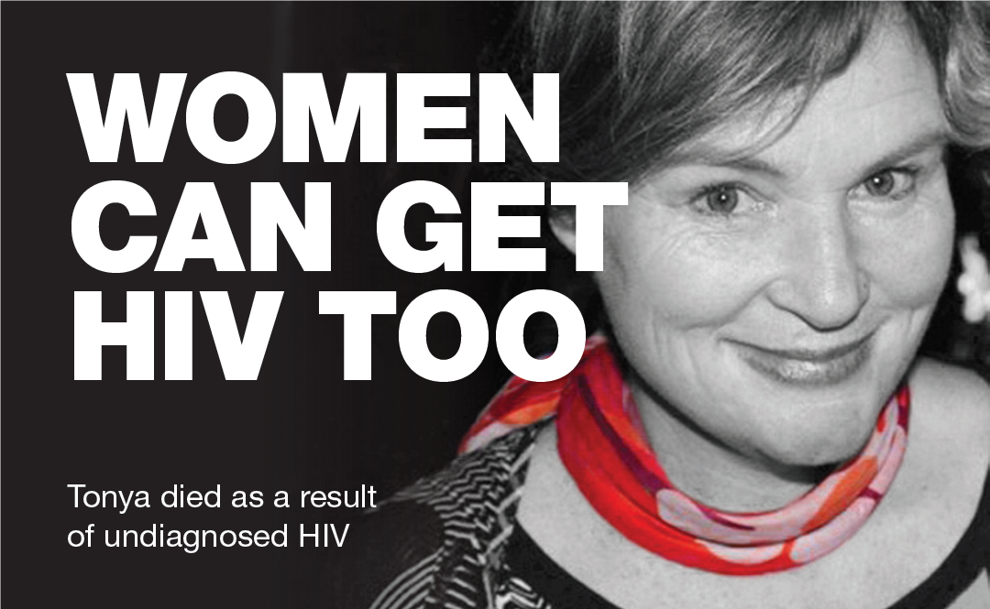
Practice and Policy Change
Routine offer of
HIV Testing

Slide 2
MSM = 128 Women = 22 MSW = 33 Transgender = 4 Unknown = 10

Slide 3
 | MSM |  | Men |  | Women
 | No. | % | No. | % | No. | %
<350 | 100 | 28.7 | 12 | 60.0 | 13 | 50.0
350-499 | 75 | 21.5 | 8 | 40.0 | 6 | 23.1
500 or more | 160 | 45.8 | 0 | 0.0 | 5 | 19.2
Unknown | 14 | 4.0 | 0 | 0.0 | 2 | 7.7
Total | 349 | 100.0 | 20 | 100.0 | 26 | 100.0
2014-2017

Slide 4
Women
MSW
MSM

Slide 5
The Booker Policy
Get sign-on at your work place
Embed a culture of routinely offering an HIV test in all diagnostic situations
Stop people from dying
STOP AIDS
TAKE
THE PLEDGE
To help change HIV testing practices in the health sector….

Slide 6
HIV to be offered routinely in
all diagnostic processes

