Slide 1
An Update from CROI and the Changing Landscape of HIV in NZ
HIV Women’s Seminar
June 2018

Slide 2
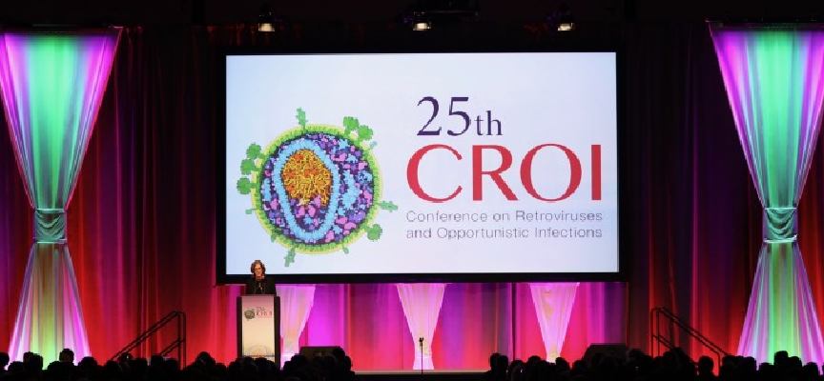

Slide 3
Objectives
Discuss importance and need for research including women
Review selected prevention and treatment themed abstracts from CROI 2018
Discuss use of dolutegravir in pregnancy
Overview of New Zealand landscape
Discussion of NZ AIDS Epidemiology Report

Slide 4
Disclosures
My attendance at CROI was funded by Auckland DHB through CPD
I am employed by Auckland DHB
I am an investigator in Merck 1439A Trial
The views expressed today are my own
Acknowledge use of slides prepared by CCO

Slide 30
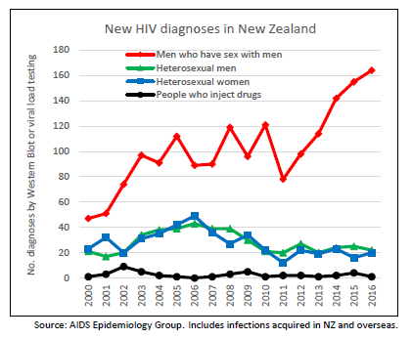

Slide 31
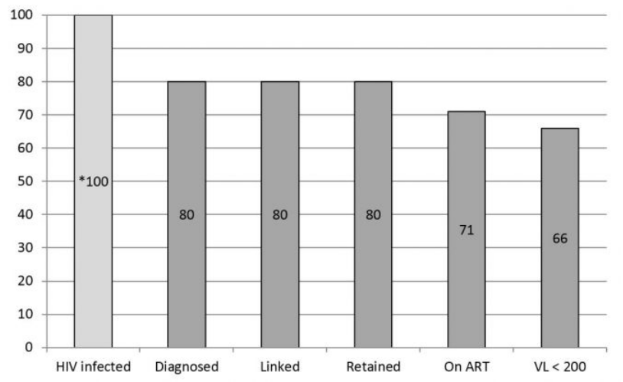
Raymond N et al. NZMJ 2016, 129:1432

Slide 32
Milestones in 2017
January 1: Health (Protection) Amendment Act (2016)
January-November: NZPreP Pilot recruiting in Auckland
May 31: National HIV/AIDS Forum Consensus Statement
July 1: Criteria for ART funding widened by Pharmac
November 14: PreP Funding announced by Pharmac

Slide 33
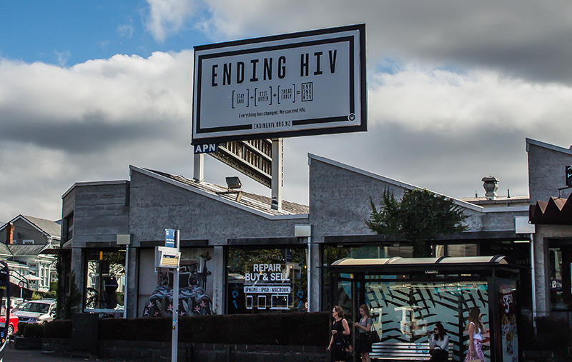

Slide 34
HIV-RT
HIV Rapid Treatment new standard of care at Auckland City Hospital
Referrals assessed and contacted same or next business day
Multidisciplinary team assessment and support
Specialist appointment and medication start within 7 days
KPI: ART initiation by 6 weeks
KPI: Undetectable by 6 months

Slide 35
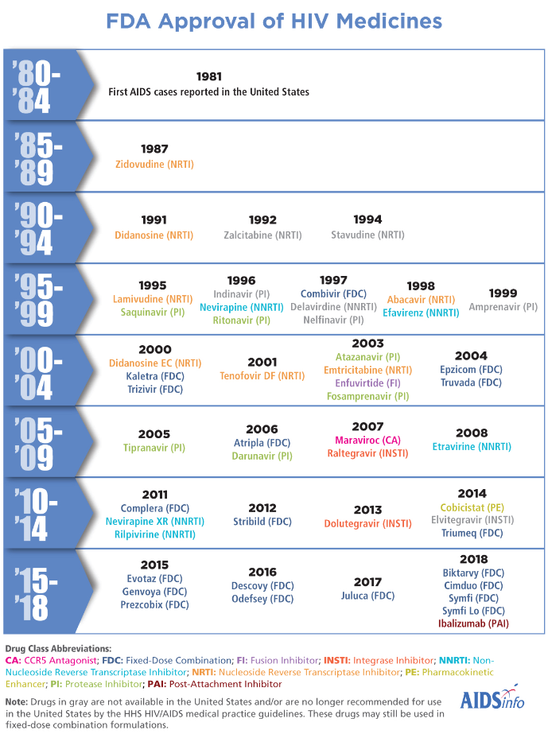

Slide 36
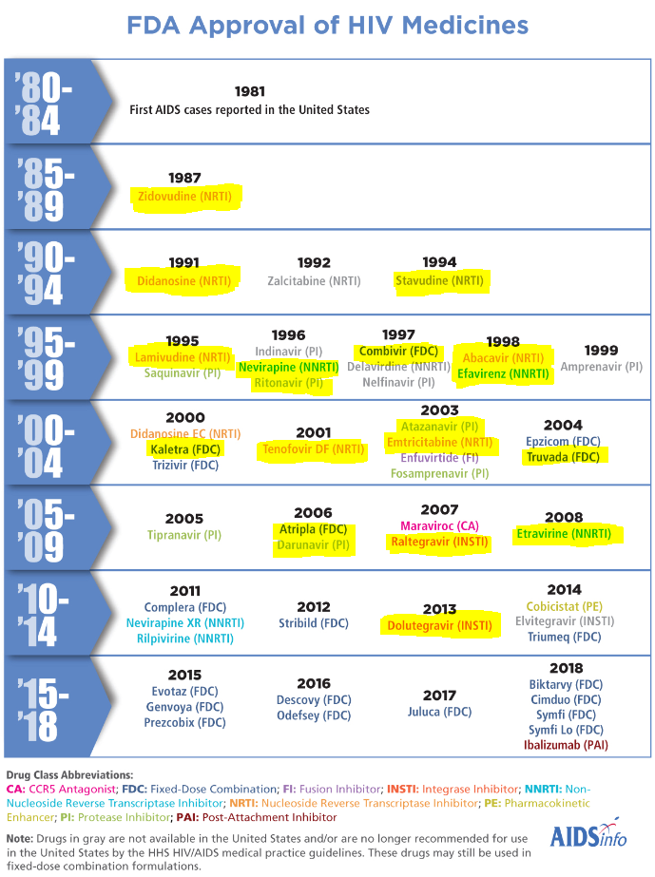

Slide 37
Improving Access to Treatments
2500 New Zealanders on ART
Includes an aging group with increasing burden of comorbid conditions, and young patients facing a lifetime of treatment
Increasing reliance on generic ART
But only one new medication funded in 5 years
And only one single tablet regimen
Need for TAF and nucleoside-sparing regimes to manage CKD and minimize nucleoside toxicity

Slide 38
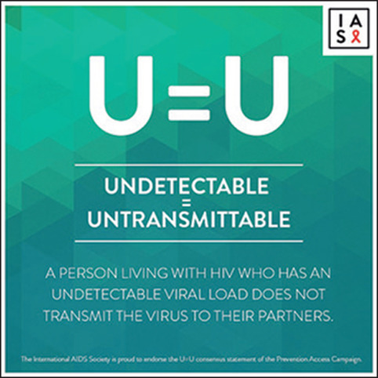

Slide 41
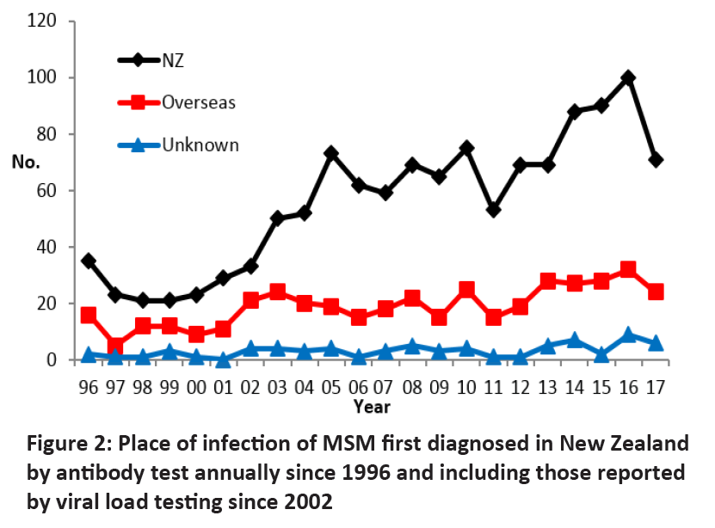

Slide 42
HIV Diagnoses 2017
197 (243); 171 men, 22 women, 4 trans
128 (164) MSM, 24 (42) hetero, 12 women
71 (100) MSM diagnosed and infected in NZ, a 30% reduction
Greatest reduction seen in Auckland
Trend to earlier diagnosis in MSM, higher proportion of late diagnosis in hetero
How can we make this sustainable?

Slide 43
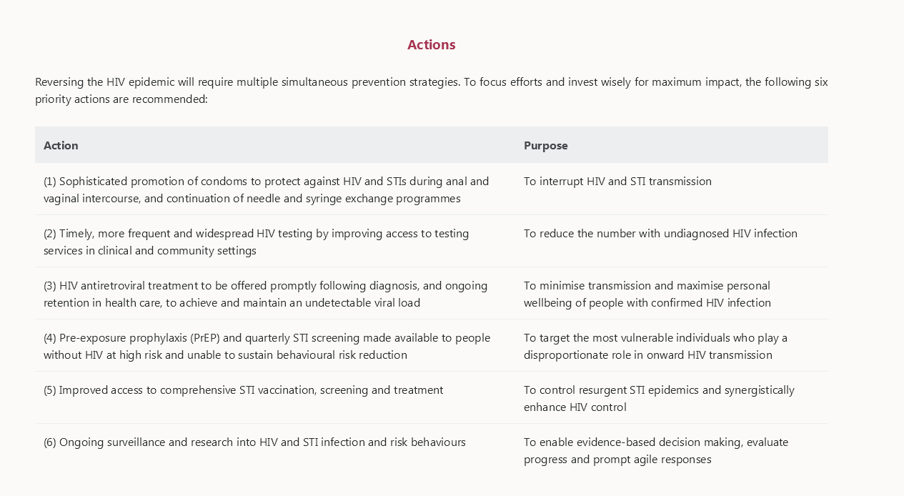

Slide 44
Do we need New Priorities for 2018?
Sustain condom promotion
Increase HIV testing in clinical and community settings
Access to better treatments for PLWHA
Address and eliminate stigma
Improve access to PrEP for those at risk
Improved access to STI vaccination, screening and treatment
Urgent need for surveillance and research

