Slide 1
HIV and dental care in NZ HIV Women’s Seminar Auckland 22 June 2018
Assoc Prof Mark Thomas
University of Auckland
Auckland City Hospital

Slide 2
Outline
Who has HIV infection in NZ?
What oral problems occur in people with HIV infection?
Are there any risks to dentists who care for people with HIV infection?

Slide 3
Who has HIV in NZ?
Approximately 3,500 people. (≈0.8/1,000 pop.)

Slide 4
Who has HIV in NZ?
Approximately 3,500 people. (≈0.8/1,000 pop.)

Slide 5
Who has HIV in NZ?
Approximately 3,500 people. (≈0.8/1,000 pop.)
IVDU 70 (≈1%) “Children” 70

Slide 6
Who has HIV in NZ?
Approximately 3,500 people. (≈0.8/1,000 pop.)
IVDU 70 (≈1%) “Children” 70
≈ 80% diagnosed

Slide 7
New HIV diagnoses in NZ 1985 - 2017
Increasing HIV incidence in MSM for last six years - mostly acquired in NZ
Decreasing HIV incidence in heterosexual men and women – mostly acquired elsewhere
Occasional HIV in IVDU
Nil perinatal HIV in last 7 years
AIDS NZ Issue 77; June 2018

Slide 8
“Cascade of Care”

Slide 9
Most people with known HIV infection have fully suppressed infection.
The major source of transmission of HIV infection is people who are not aware of their diagnosis.

Slide 10
Treatment is extremely effective
The level of HIV in blood in patients who take their medicines consistently
falls from
10,000s – 100,000s
to almost always be
less than 100 viruses/mL
= “non-infectious”.
1,000,000
100,000
10,000
1,000
100
10

Slide 11
Treatment is extremely effective
There has been a dramatic decline in AIDS illnesses and deaths
Many patients take only one or two pills per day
AIDS NZ Issue 77; June 2018

Slide 12
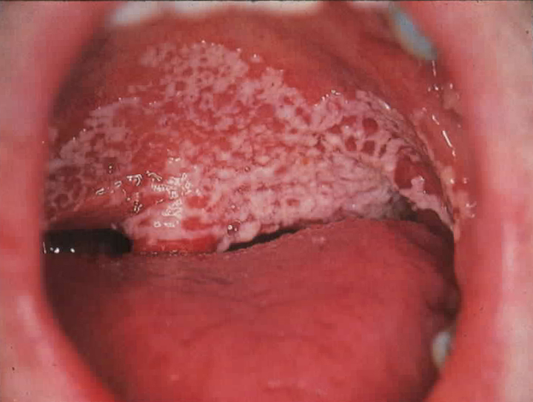
Oral problems in people with HIV infection are now very rare
Thrush – Candida albicans Oral Hairy Leukoplakia - Epstein-Barr Virus
Giant aphthous ulcers – unknown Kaposi’s Sarcoma - HHV8

Slide 13
The elephant in the room!
1987 US dentist with AIDS (Kaposi’s Sarcoma)
Treated with AZT.
Stopped work.
5 patients treated between 1987 and 1989
acquired HIV infection,
as the result of their dental care. How?
Annals of Internal Medicine 1992;116:798-805.

Slide 14
Risks to dentists caring for people with HIV infection?
Occupation | Documented transmission | Possible transmission | Total
Nurse/midwife | 56 | 72 | 128
Doctor/medical student | 14 | 28 | 42
Surgeon | 1 | 17 | 18
Dentist/dental worker | 0 | 8 | 8
Clinical lab worker | 17 | 22 | 39
other | 18 | 91 | 109
Total | 106 | 238 | 344
Occupational Transmission of HIV Infection HPA (UK) 2005

Slide 15
Risks to dentists from patients with HIV infection?
Concentration of HIV in saliva:
VERY MUCH less than in serum, and inactivated.
Amount of fluid inoculated:
usually very small amounts
Depth of inoculation:
usually shallow
usually negligible risk

Slide 16
Recap
Who has HIV infection in NZ?
What oral problems occur in people with HIV infection?
Are there any risks to dentists who care for people with HIV infection?
mostly MSM (2/3) and heterosexuals who became infected elsewhere
none, candidiasis, aphthous ulcers, leukoplakia, Kaposi’s sarcoma
essentially zero risk of acquiring infection

